Slide 1

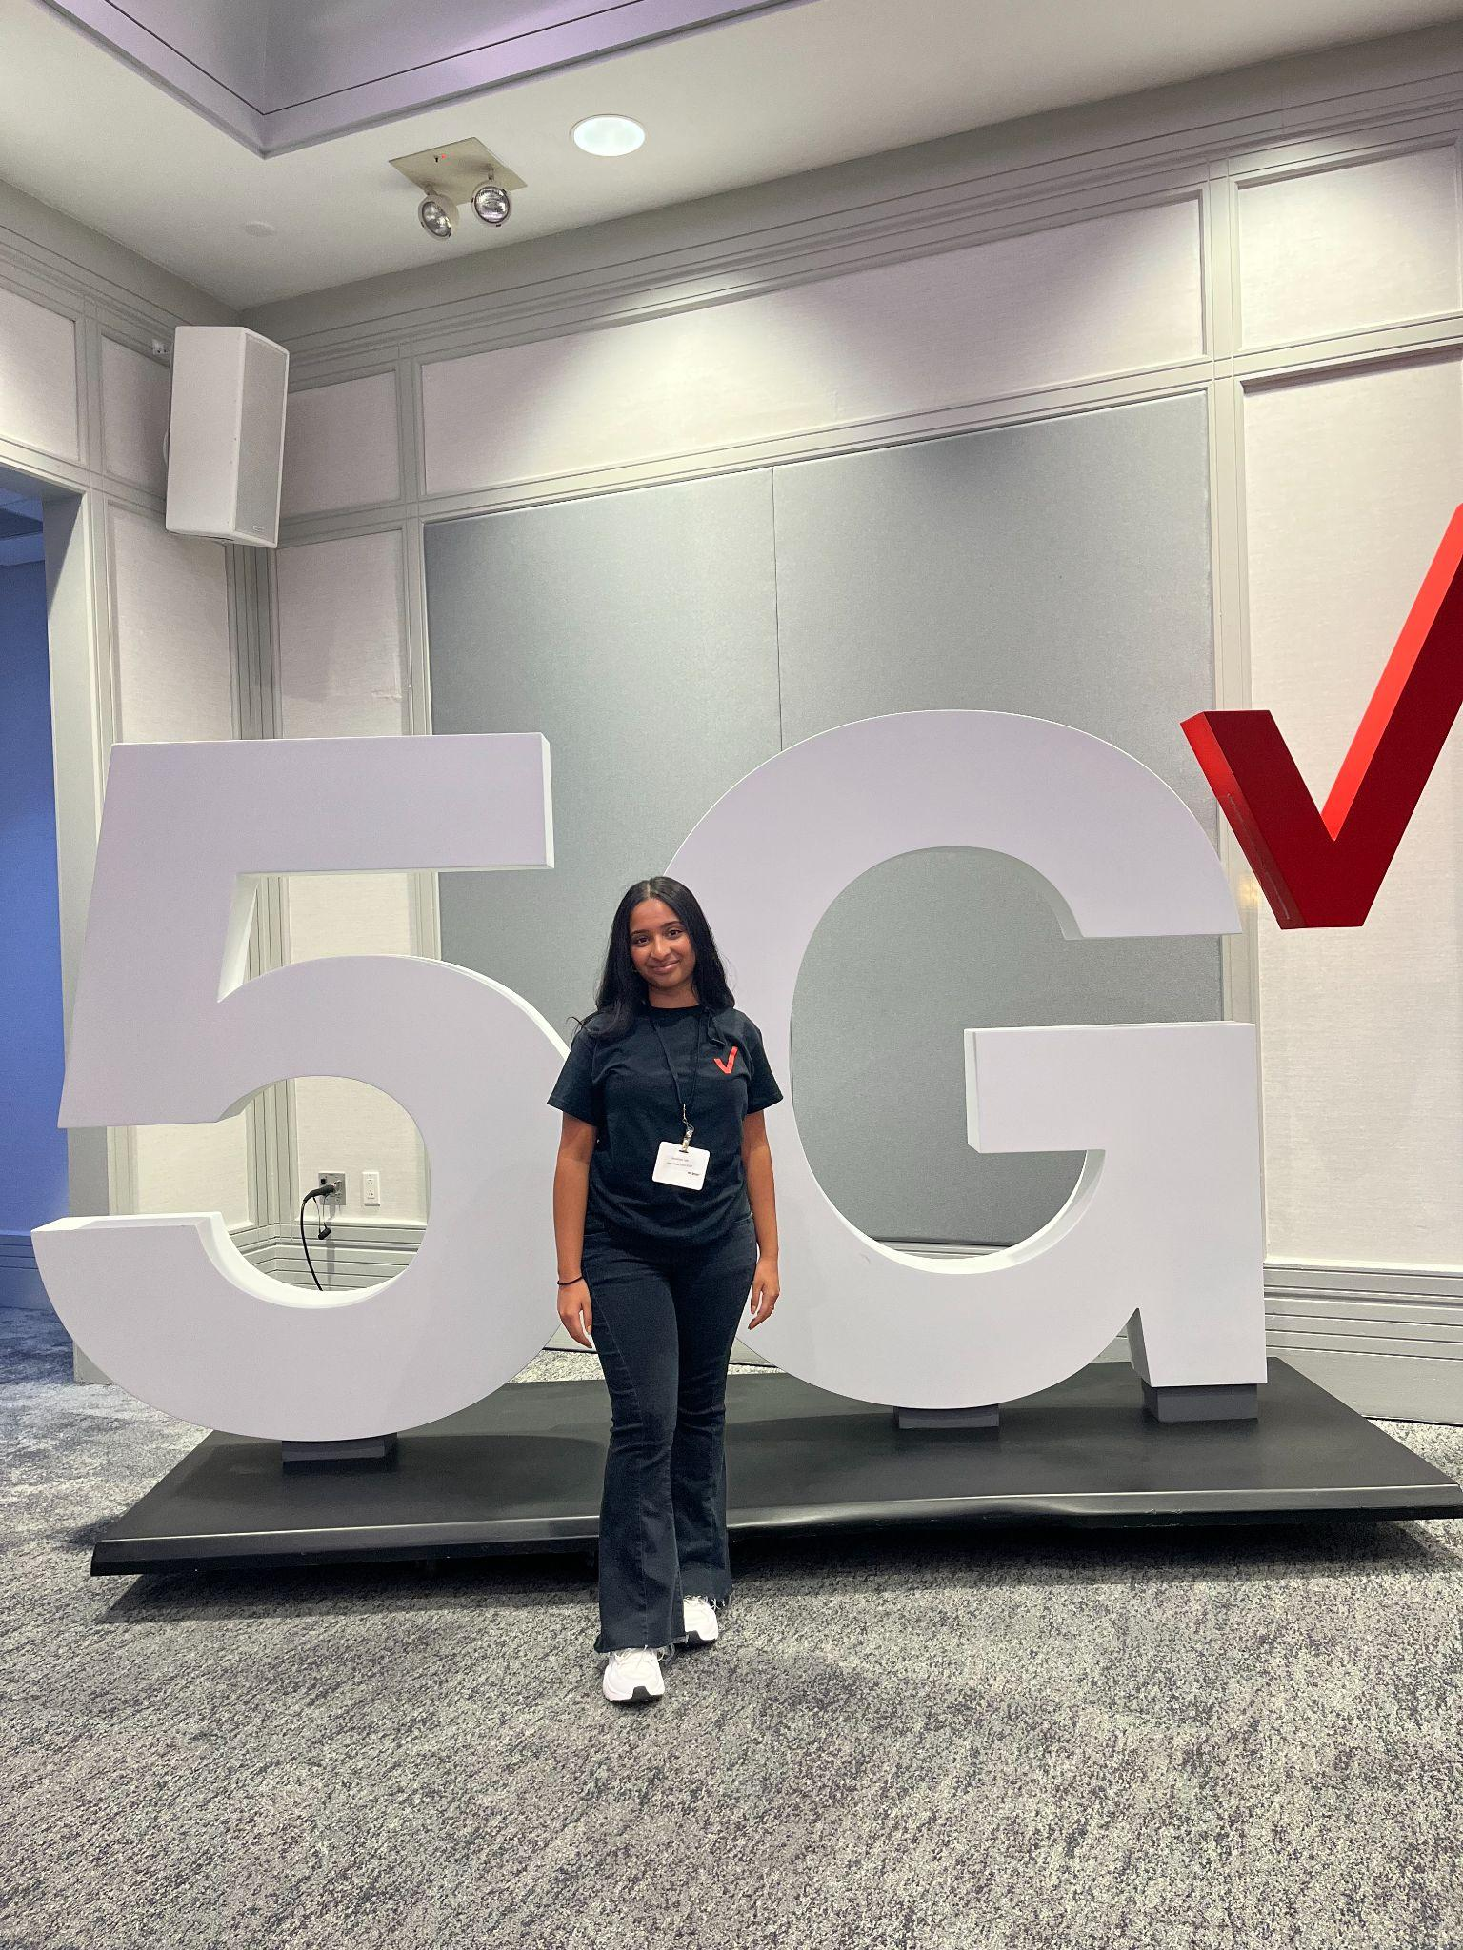
Keerthana Talla
School: Rutgers University
Major: Computer Science
GN&T Intern
Fami Ali (Sr. Manager)
Tommy Elliot (Director)
Network Management Center (NMC)

Slide 2
Project Background & Overview
Problem:
Recording Losses of Diversity (LOD) and outages is a manual, error-prone process. Inputting data into a google sheet and retrieving information is time-consuming and has many limitations.
Solution:
An automation tool designed to make recording and retrieving losses of diversity (LODs) and outages simplified and time-efficient through the use of a slack bot and a database.
Control input to avoid inconsistencies
Easier communication between teams
All data in one place
Easy data retrieval
Loss of Diversity:
No backup protection of the network created by a loss of redundant connections.

Slide 3
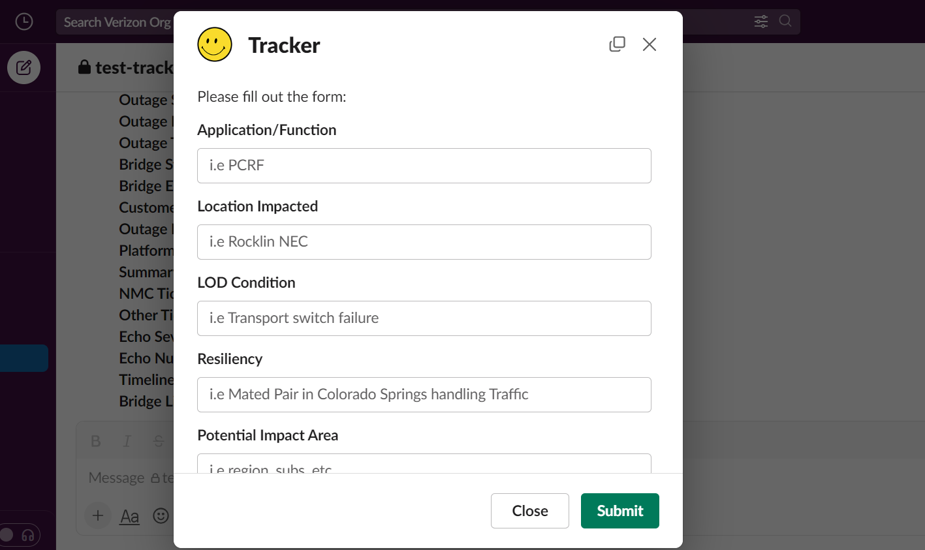
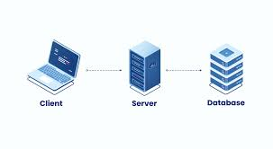
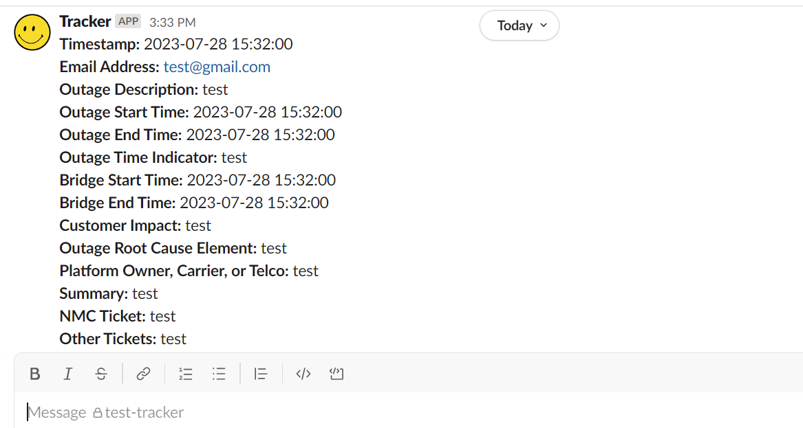
Implementation: Meet Tracker
Using Python and Slack Bolt API, forms are sent to slack. Date or time inputs have a structured format.
Using Oracle and SQL, the inputted data is sent to a database where it is stored. Date and time inputs are stored in Epoch form.
The data from the database can be retrieved from specific commands.
Notes:
Key aspects: communication - multiple confirmations of what the team wants, lots of research into slack apps, and the best way to tackle dates and time in different time zones

Slide 4
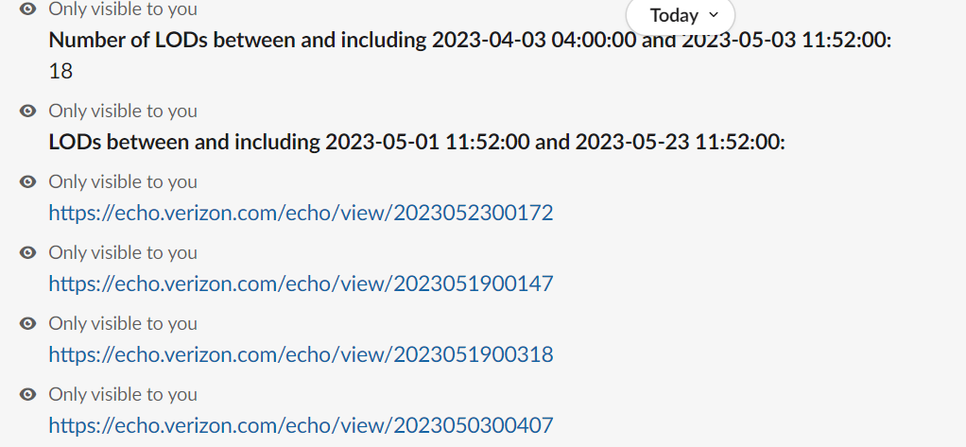
Bot Features
LOD retrieval
Outage retrieval
Returns number of LODs between given dates
Returns number of outages that occurred between given dates
Returns LODs occurred between given dates
Returns outages occured between given dates

Slide 5
Results of Project
Saves at least 15 minutes per shift per engineer
Reduces errors
Simplifies filling reports
Easy information retrieval during important calls
15 minutes daily
821.25 hours
annually
~ $60k
annually
Notes:
-inconsistencies with data -> time wasted in confusion and lack of clarity about the event
- easy to file reports

Slide 6
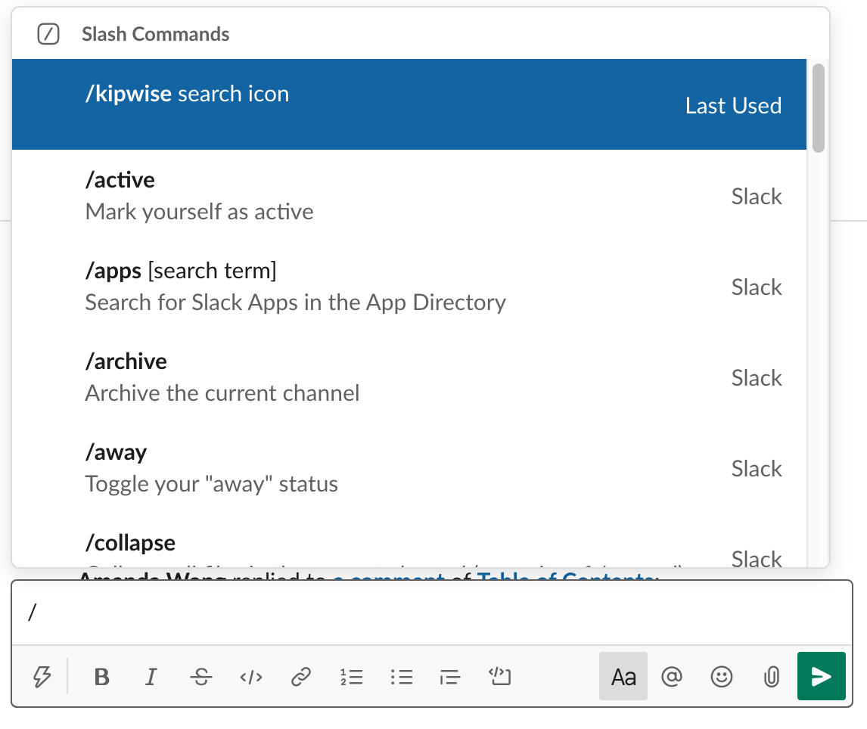

Future Work
Create more commands to access different types of information
Use web-scraping tools to auto-fill information from echo.verizon.com

Slide 7
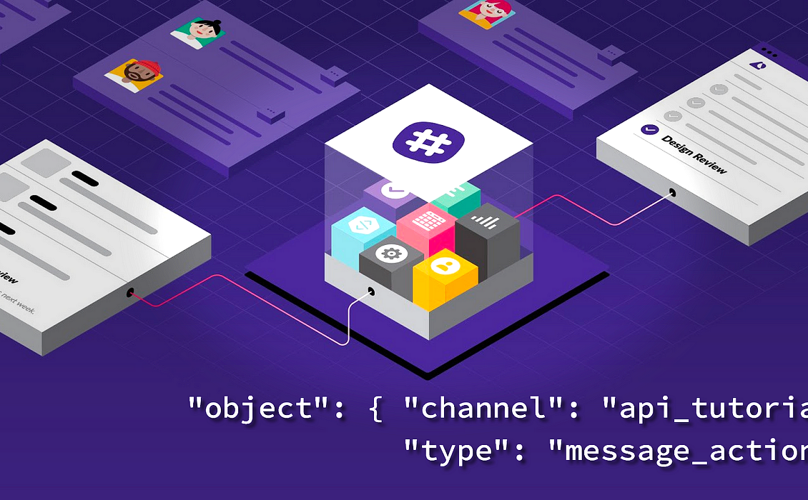
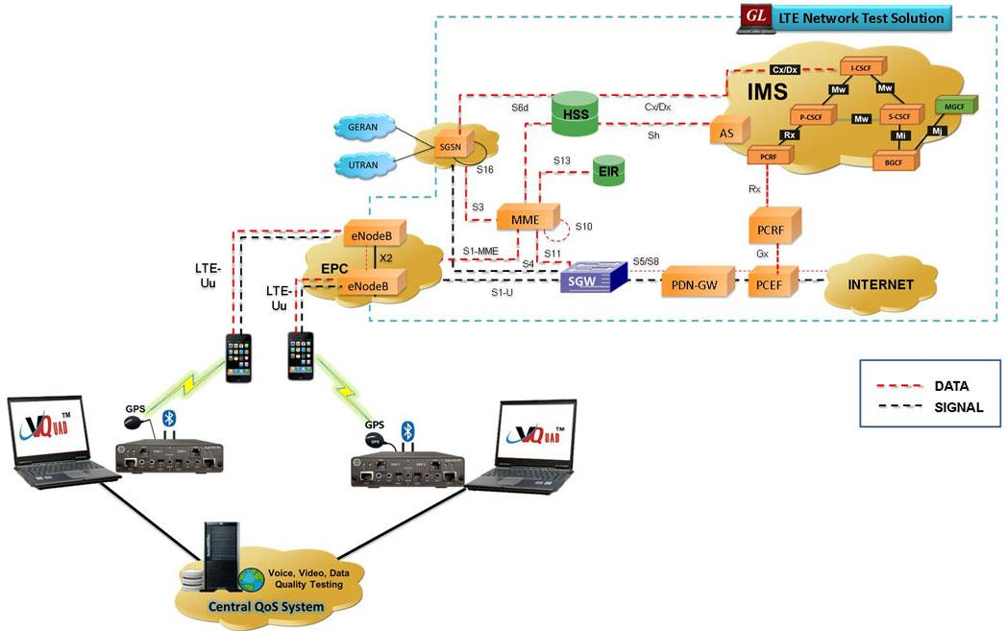

Internship Learning Experience
Technical Skills:
Oracle Instant Client/SQL
Python
Bolt API
Slack App Development
Network Skills/Takeaways:
Responding to network failures
IrisView
VoLTE, IMS, network elements
Hierarchical structure of running a network
Soft Skills:
Communication
Asking the right questions/taking notes
Reaching out
Participating in work culture
Notes:
Received a really good understanding of payloads, string manipulation, and how the database communicates with slack

Slide 8
Q&A
utilization_gbps
Notes:
My time at verizon has definitely made an impact on me and I hope I have made an impact on my team. Thank you,

